Slide 1
Embryology and anatomy of the female genital tract
Dr Mathews
MD, MPH ,AssoRCOG, FWACS

Slide 2
The Embryology

Slide 3
Development of Reproductive Organs
Gonadal ridge: forms in embryo at 5 weeks and gives rise to gonads. The primary germ cells originate in the yolk sac.
Wolffian ducts: form male duct (vas deferens)
Mullerian ducts: form female duct (uterine tube)
  Both ducts are present in embryo-only one develops!
External genitalia develops from same structures
  Labioscrotal swelling: Scrotum = Labia majora
  Urethral folds: Penile Urethra = Labia minora
  Genital tubercle: Penis = Clitoris

Slide 4
Female Development
Ovaries descend into pelvis
Vaginal process: out-pocketing of peritoneum guides descent
Gubernaculum: guides descent of ovaries; attached to labia majora
  caudal portion = round ligament of uterus
  cranial portion = ovarian ligament

Slide 5
FEMALE REPRODUCTIVE ANATOMY

Slide 6
EXTERNAL GENITALIA
The vulva refers to those parts that are outwardly visible
The vulva includes:
Mons pubis
Labia majora
Labia minora
Clitoris
Urethral opening
Vaginal opening
Perineum
Individual differences in:
Size
Coloration
Shape
Of external genitalia are common

Slide 7
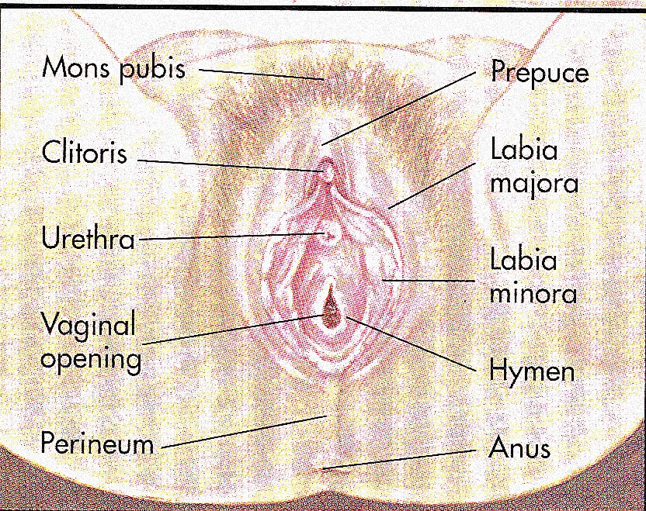

Slide 8
MONS PUBIS
The triangular mound of fatty tissue that covers the pubic bone
It protects the pubic symphysis
During adolescence sex hormones trigger the growth of pubic hair on the mons pubis
Hair varies in coarseness curliness, amount, color and thickness

Slide 9
LABIA MAJORA
Referred to as the outer lips
They have a darker pigmentation
The Labia Majora:
Protect the introitus and urethral openings
Are covered with hair and sebaceous glands
  labia minora: smaller, hairless folds inside labia major
Tend to be smooth and moist
Become flaccid with age and after childbirth

Slide 10
CLITORIS
Highly sensitive organ composed of nerves, blood vessels, and erectile tissue
Located under the prepuce
It is made up of a shaft and a glans
Becomes engorged with blood during sexual stimulation
Key to sexual pleasure for most women
  Urethral opening is located directly below, it is superior to vestibule
    crura, prepuce, corpus cavernosum
    NO corpus spongiosum

Slide 11
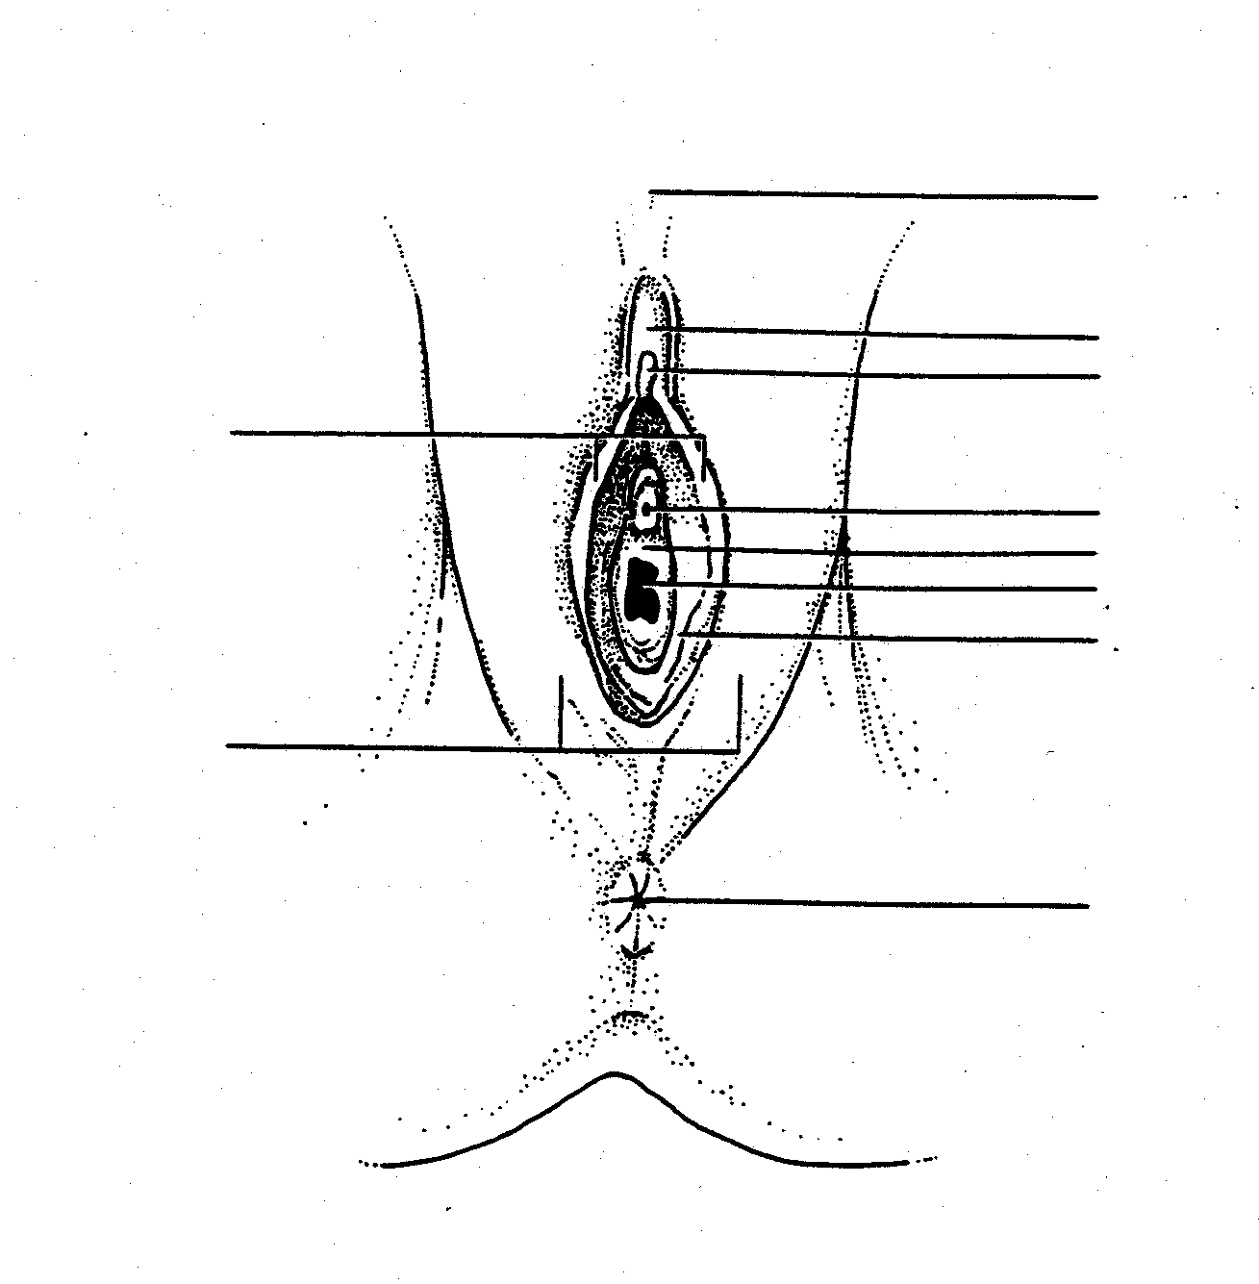
FEMALE

Slide 12
VAGINAL OPENING
INTROITUS
Opening may be covered by a thin sheath called the hymen
Using the presence of an intact hymen for determining virginity is erroneous
Some women are born without hymens
The hymen can be perforated by many different events

Slide 13
PERINEUM
The muscle and tissue located between the vaginal opening and anal canal
It supports and surrounds the lower parts of the urinary and digestive tracts
The perineum contains an abundance of nerve endings that make it sensitive to touch
An episiotomy is an incision of the perineum used during childbirth for widening the vaginal opening

Slide 14
INTERNAL GENITALIA
The internal genitalia consists of the:
Vagina
Cervix
Uterus
Fallopian Tubes
Ovaries

Slide 15
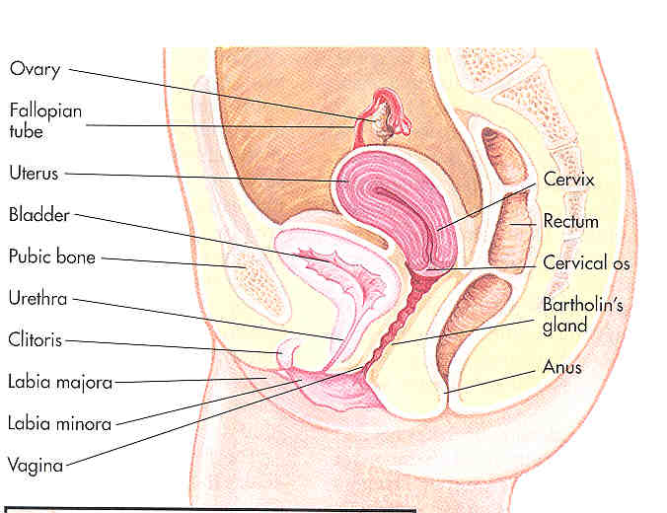

Slide 16
VAGINA
The vagina connects the cervix to the external genitals
It is located between the bladder and rectum
It functions :
As a passage way for the menstrual flow
For uterine secretions to pass down through the introitus
As the birth canal during labor
With the help of two Bartholin’s glands becomes lubricated during SI
Vagina have 3 layers, thinner
  vaginal orifice

Slide 17
CERVIX
The cervix connects the uterus to the vagina
The cervical opening to the vagina is small
This acts as a safety precaution against foreign bodies entering the uterus
During childbirth, the cervix dilates to accommodate the passage of the fetus
This dilation is a sign that labor has begun

Slide 18
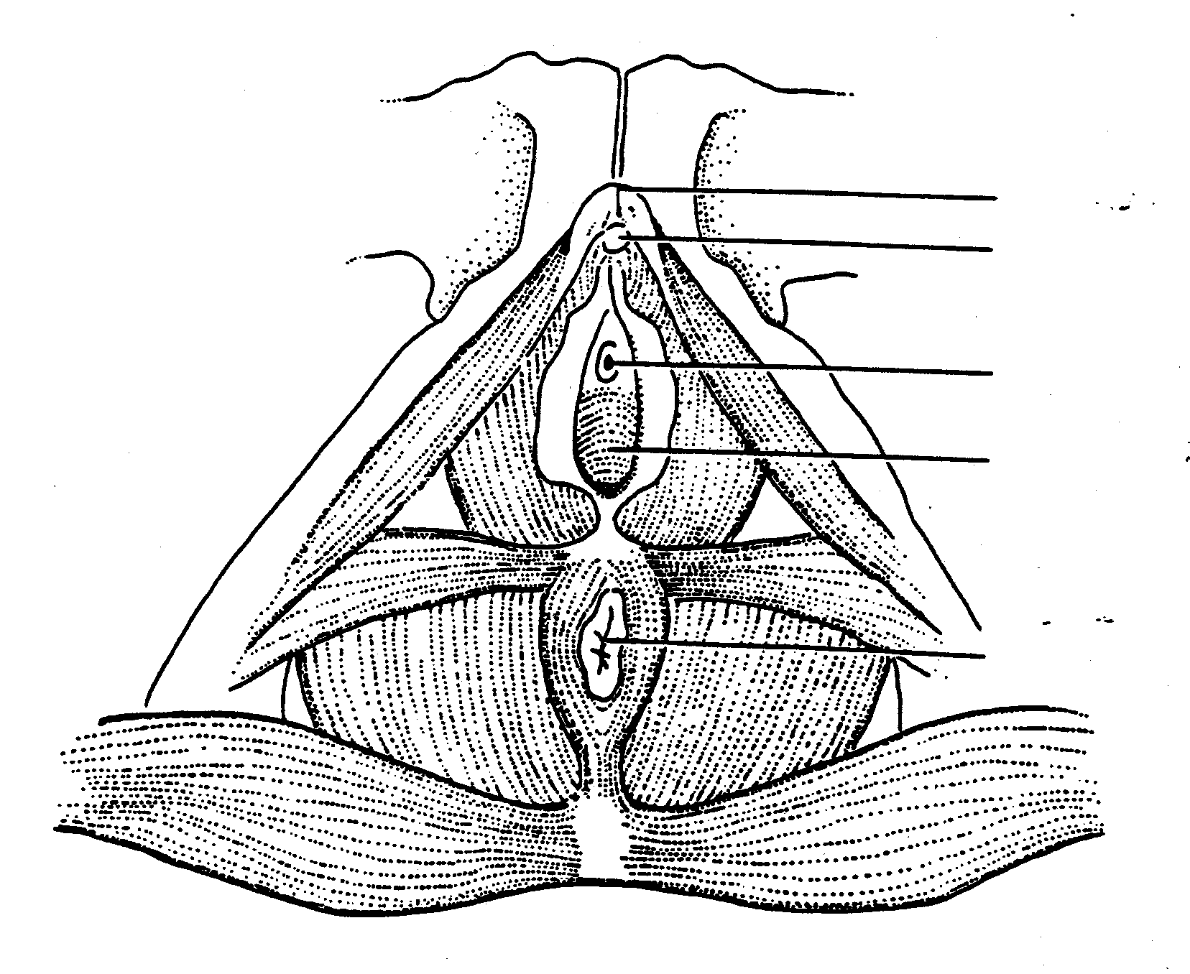
PERINEUM

Slide 19
UTERUS
Commonly referred to as the womb
A pear shaped organ about the size of a clenched fist
It is made up of the endometrium, myometrium and perimetrium
Consists of blood-enriched tissue that sloughs off each month during menstrual cycle
The powerful muscles of the uterus expand to accommodate a growing fetus and push it through the birth canal

Slide 20
The Uterus
Uterus
  3 Layers
    perimetrium
    myometrium
    endometrium
  Anatomy
    fundus
    body
    isthmus
    cervix
  Location
    anterior to rectum
    posterior to bladder

Slide 21
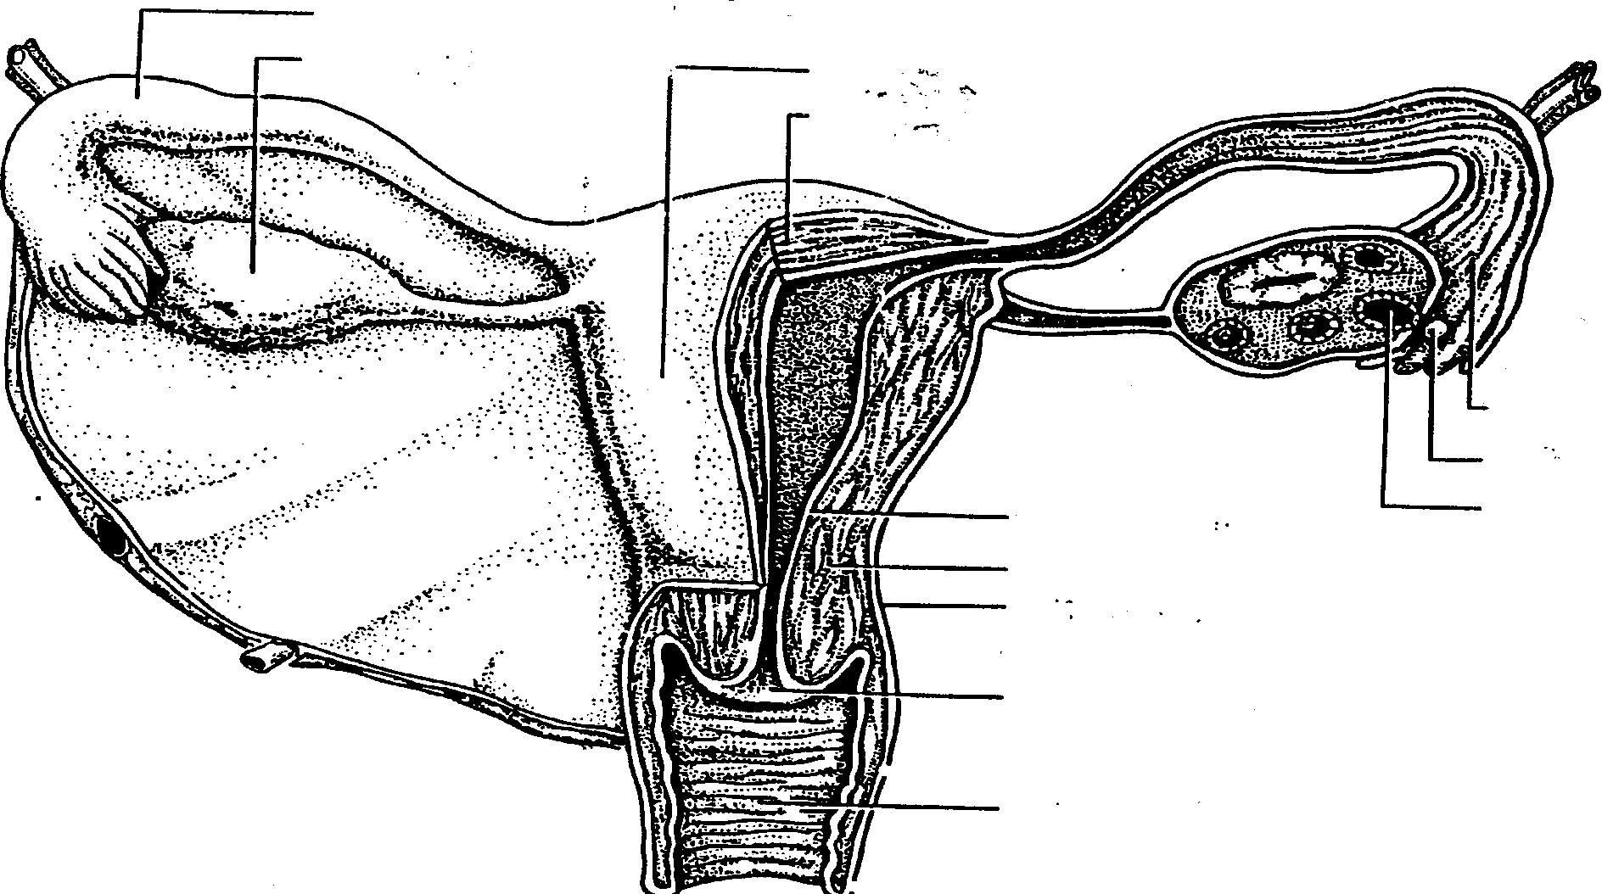
OVIDUCTS

Slide 22
FALLOPIAN TUBES
Serve as a pathway for the ovum to the uterus
Are the site of fertilization by the male sperm
Often referred to as the oviducts or uterine tubes
Fertilized egg takes approximately 3 to 7days to travel through the fallopian tube to implant in the uterine lining

Slide 23
Oviduct
Muscular tube 12 cm long
Upper end opens into peritoneal cavity near ovary
Lower end passes through the uterus wall
4 segments
  intramural part in uterine wall (cornue)
  isthmus is adjacent to uterine wall
  ampulla is dilated part
  infundibulum is funnel-shaped part near ovary with fimbriae

Slide 24
The Fallopian tube (Oviduct)
Uterine tubes = Oviducts
  from near ovaries to uterus
  infundibulum
    expanded, proximal portion
    fimbrae on edges
Movement of Ova in Oviduct
  receives oocyte after ovulation
  peristaltic waves
  cilia lining tube
  contains cells to nourish ova
Site of fertilization
Ectopic pregnancy: implantation of zygote outside of uterus

Slide 25
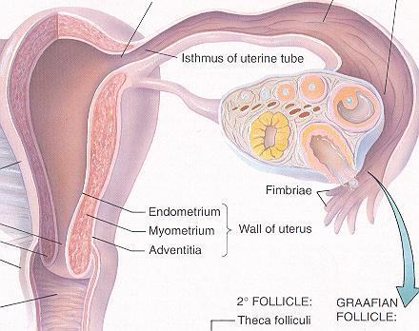

Slide 26
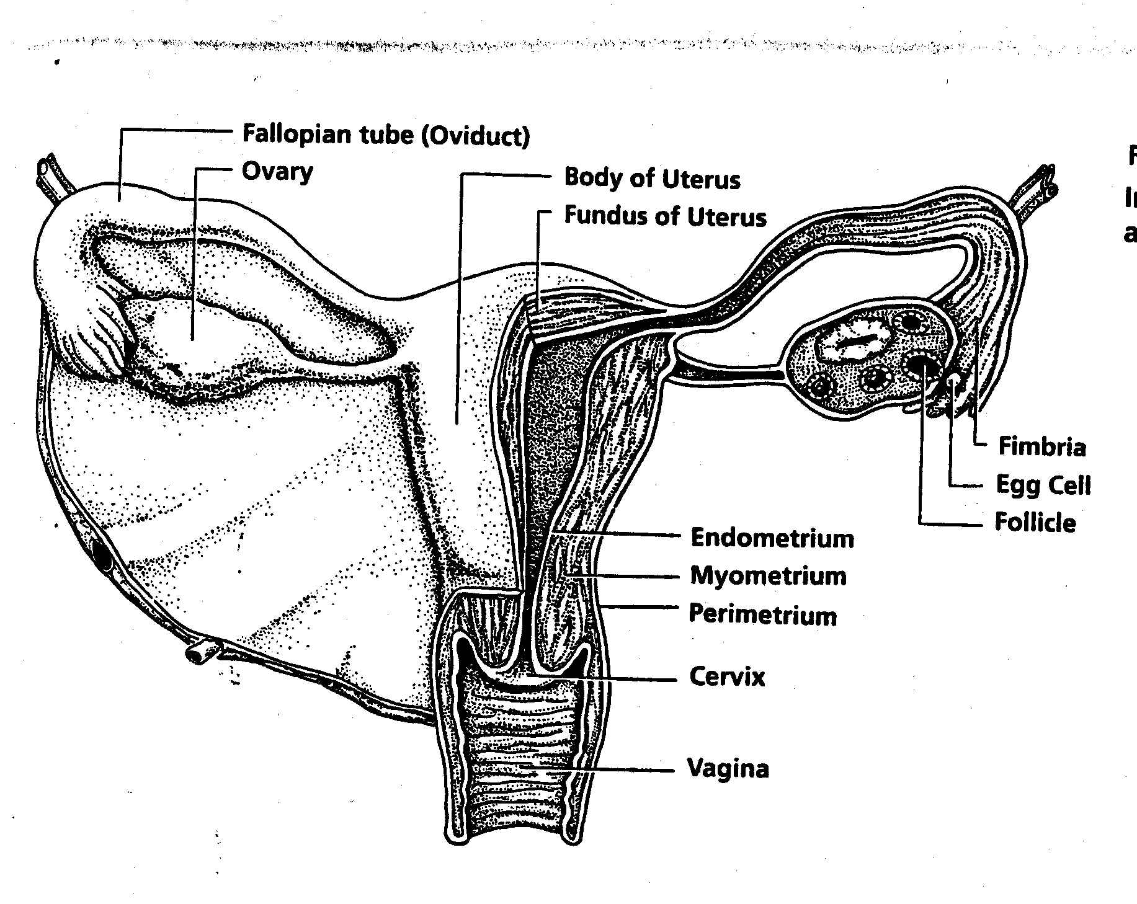

Slide 27
OVARIES
The female gonads or sex glands
They develop and expel an ovum each month
A woman is born with approximately 400,000 immature eggs called follicles
During a lifetime a woman release @ 400 to 500 fully matured eggs for fertilization
The follicles in the ovaries produce the female sex hormones, progesterone and estrogen
These hormones prepare the uterus for implantation of the fertilized egg

Slide 28
The Ovary
Ovaries (paired)
  produce and store ova (eggs)
  Tunica albuginea - surrounds each ovary
Arterial Supply
  Ovarian artery
  branches of Uterine artery
Ligaments
  Ovarian ligament
    connects ovaries to uterine wall (medial)
  Suspensory ligament
    connects ovaries pelvic wall (lateral)
  Broad ligament
    supports uterus, oviducts

Slide 29
Ovary
Almond shaped, 3 cm X 1.5 cm
Medulla with vessels and loose connective tissue
Cortex with ovarian follicles and oocytes
Cortical stroma has fibroblast-like cells
Surface has simple squamous/cuboidal germinal epithelium covering thick layer of dense irregular connective tissue, the tunica albuginea

Slide 30
Nerve and Arterial supply of the female genital tract
Innervation: branches of Pudendal nerve
Arterial Supply:
  Uterine arteries + arcuate branches of hypogastric vessels = uterus
  Ovarian arteries + ovarian branches of uterine arteries = ovaries

Slide 31
Developmental abnormalities

Slide 32
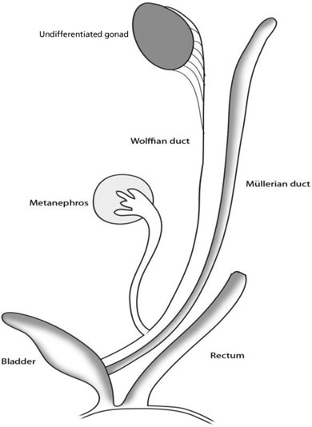
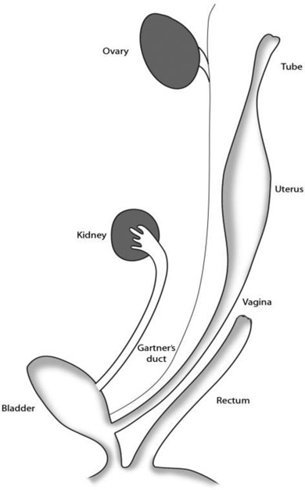
Undifferentiated
Differentiated

Slide 33
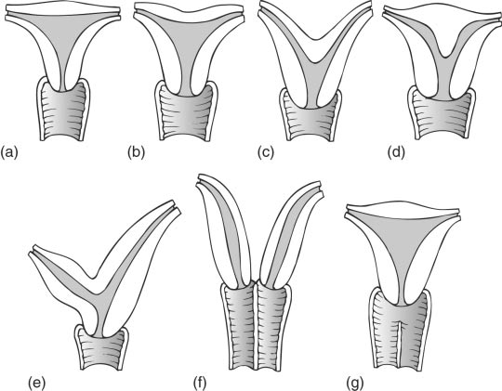
Various fusion abnormalities of the uterus and vagina.
(a) Normal
appearance; (b) arcuate fundus with little
effect on the shape of the cavity; (c)
bicornuate uterus; (d) subseptate uterus
with normal outline; (e) rudimentary horn;
(f) uterus didelphys; (g) normal uterus
with partial vaginal septum.

Slide 34
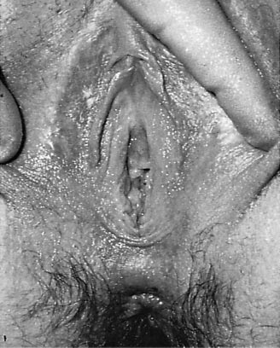
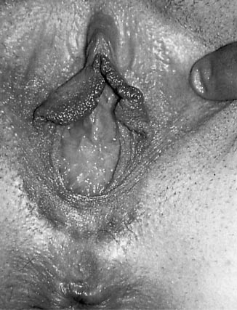
Vulval appearances in a case of absence of the vagina.
An imperforate membrane occluding the vaginal introitus in a case of haematocolpos.

Slide 35
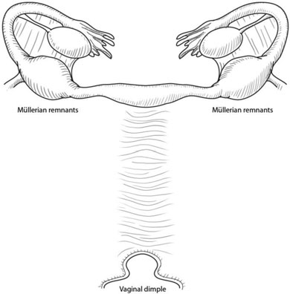
MRKH syndrome

Slide 36
Key Points
A common presentation is primary amenorrhoea in a female with 46,XX karyotype and normal secondary sexual characteristics.
There may be associated abnormalities of the kidneys, skeletal system, heart and auditory system.
Magnetic resonance imaging or CT scan is a useful diagnostic tool with which to assess the anatomical abnormalities.
Management involves psychological support, simple excision, hysteroscopic resection, Metroplasty, Graduated glass dilators and creation of a neovagina for sexual function.

